Slide 1

INFDEV036A - Algorithms Lesson Unit 4
G. Costantini, F. Di Giacomo
costg@hr.nl, giacf@hr.nl – Office H4.206

Slide 2
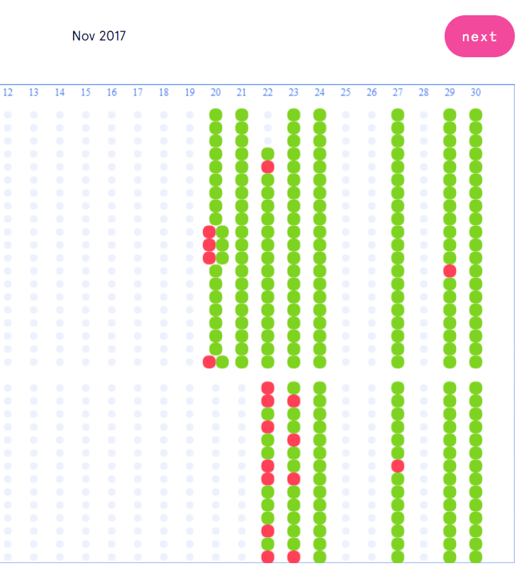
Homework progress
Have you completed all MC questions in GrandeOmega?
Have you implemented all algorithms+data structures seen in the previous lessons?

Slide 3
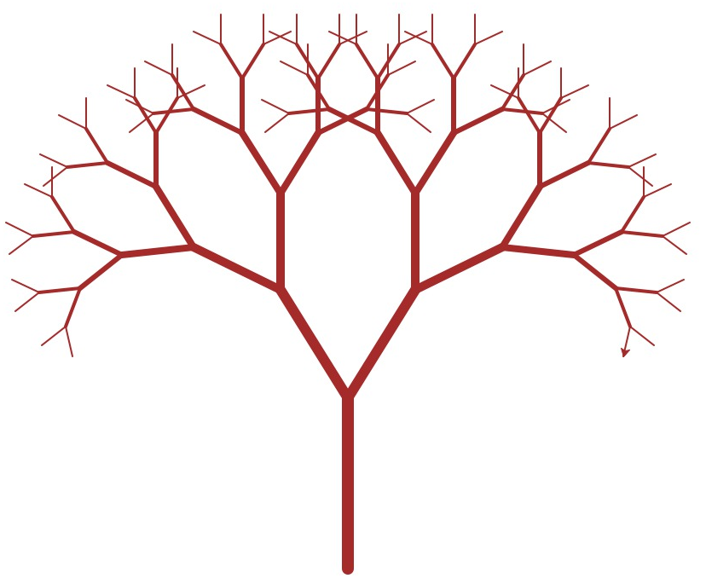
Today
Why is my code slow?
Empirical and complexity analysis
How do I order my data?
Sorting algorithms
How do I structure my data?
Linear, tabular, recursive data structures
How do I represent relationship networks?
Graphs
BINARY TREES

Slide 4
Detailed agenda
What is a tree?
What is a binary tree?
What is a binary search tree?
What is a 2-3 tree? [only short hint to basic idea]
What is a k-d tree? [only short hint to basic idea]

Slide 5
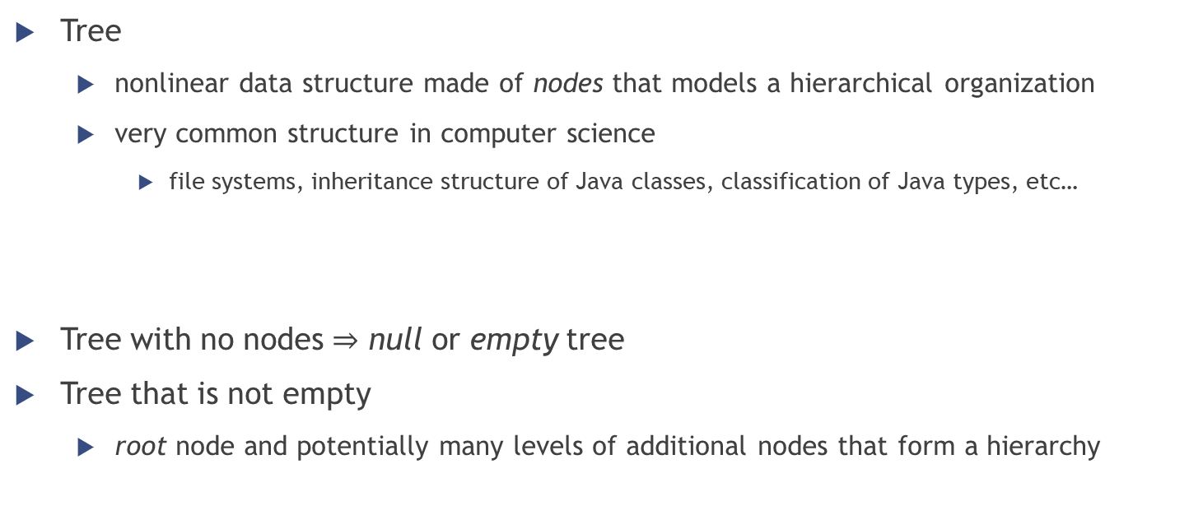
Tree definition
Tree
nonlinear data structure made of nodes that models a hierarchical organization
very common structure in computer science
file systems, inheritance structure of Java classes, classification of Java types, etc…
Tree with no nodes $⇒$ null or empty tree
Tree that is not empty
root node and potentially many levels of additional nodes that form a hierarchy

Slide 6
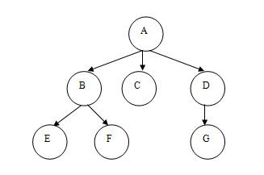
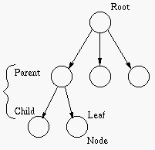
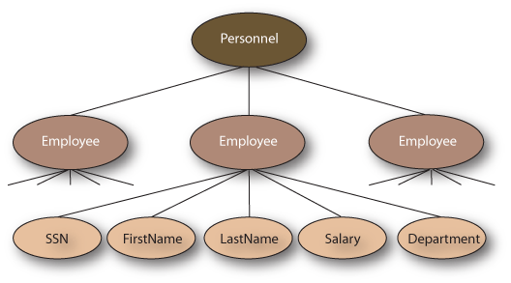
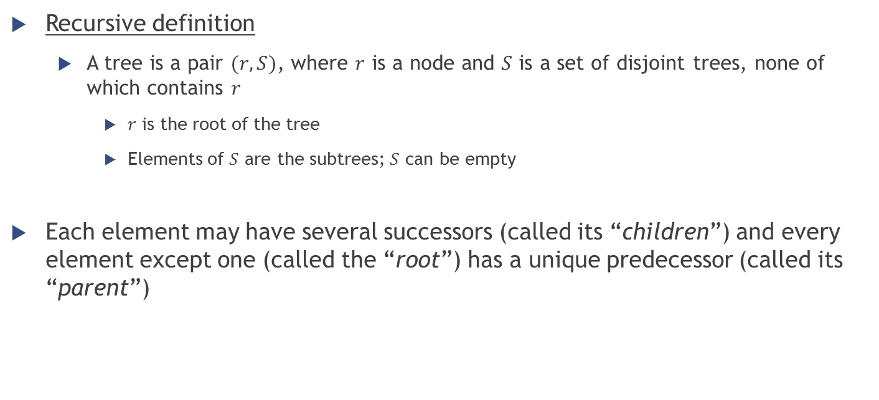
Tree definition
Recursive definition
A tree is a pair $(r, S)$, where $r$ is a node and $S$ is a set of disjoint trees, none of which contains $r$
$r$ is the root of the tree
Elements of $S$ are the subtrees; $S$ can be empty
Each element may have several successors (called its “children”) and every element except one (called the “root”) has a unique predecessor (called its “parent”)

Slide 7
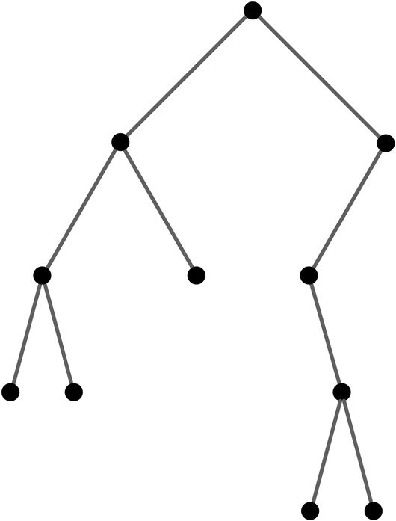
Binary Trees

Slide 8
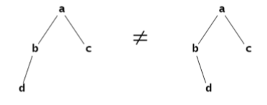
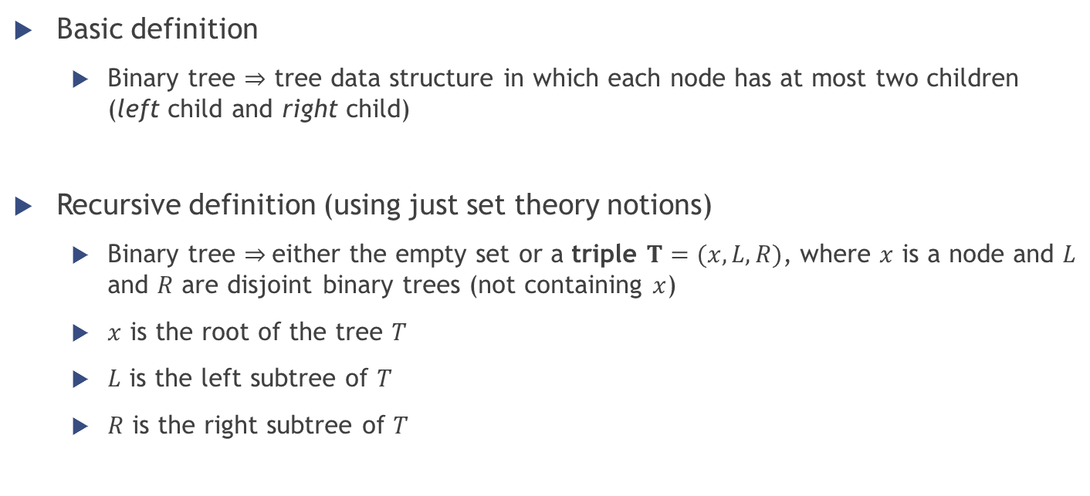
Binary tree definition
Basic definition
Binary tree $⇒$ tree data structure in which each node has at most two children (left child and right child)
Recursive definition (using just set theory notions)
Binary tree $⇒$either the empty set or a triple $T=(x, L, R)$, where $x$ is a node and $L$ and $R$ are disjoint binary trees (not containing $x$)
$x$ is the root of the tree $T$
$L$ is the left subtree of $T$
$R$ is the right subtree of $T$

Slide 9
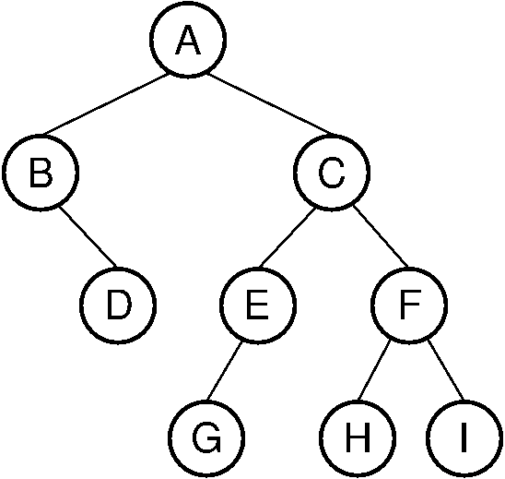
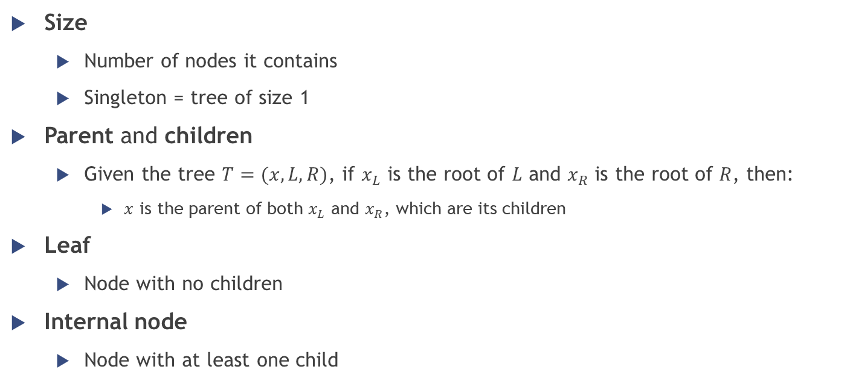
Binary trees properties (1/3)
Size
Number of nodes it contains
Singleton = tree of size 1
Parent and children
Given the tree $T=(x,L,R)$, if $x_{L}$ is the root of $L$ and $x_{R}$ is the root of $R$, then:
$x$ is the parent of both $x_{L}$ and $x_{R}$, which are its children
Leaf
Node with no children
Internal node
Node with at least one child

Slide 10
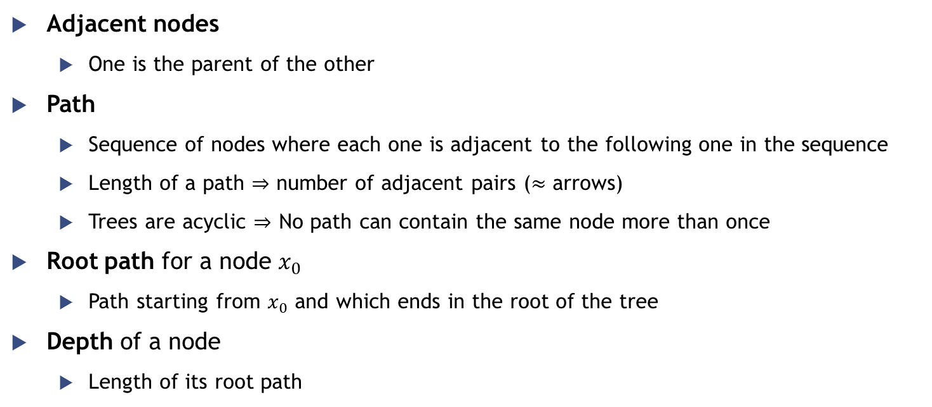
Binary trees properties (2/3)
Adjacent nodes
One is the parent of the other
Path
Sequence of nodes where each one is adjacent to the following one in the sequence
Length of a path $⇒$ number of adjacent pairs ($≈$ arrows)
Trees are acyclic $⇒$ No path can contain the same node more than once
Root path for a node $x_{0}$
Path starting from $x_{0}$ and which ends in the root of the tree
Depth of a node
Length of its root path

Slide 11
Binary trees properties (3/3)
Level
Set of all nodes at a given depth
Height
Greatest depth among its nodes
Height of a singleton is 0
Height of the empty tree is -1

Slide 12
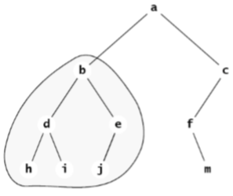

Binary trees properties – Example
Size?
10
Height?
3
Root node?
a
Path $(a,b,e,i)$ is valid?
No

Slide 13

Binary trees properties – Example
Path $(a,b,d)$ is valid?
Yes. Length of the path?
2
Level 2 of the tree?
$\{ d, e, f \}$
Depth of node $c$?
1
Subtree rooted at $c$?
$c→f→m$

Slide 14
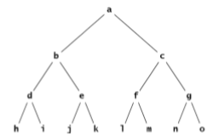
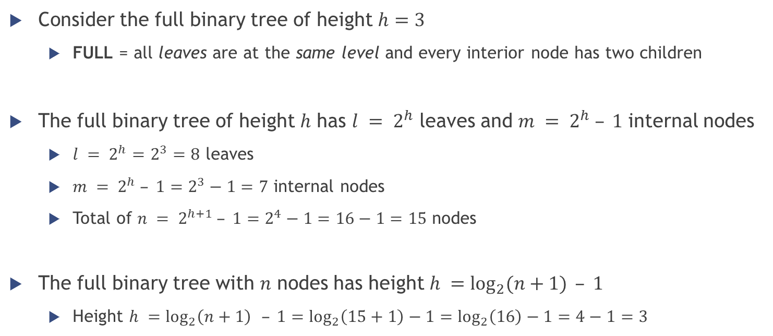
Full binary trees
Consider the full binary tree of height $h=3$
FULL = all leaves are at the same level and every interior node has two children
The full binary tree of height $h$ has $l = 2^{h}$ leaves and $m = 2^{h} – 1$ internal nodes
$l = 2^{h}=2^{3}=8$ leaves
$m = 2^{h} – 1=2^{3}−1=7$ internal nodes
Total of $n = 2^{h+1} – 1=2^{4}−1=16−1=15$ nodes
The full binary tree with $n$ nodes has height $h =\log_{2}{(n+1)}⁡ – 1$
Height $h =\log_{2}\left(n+1\right){ }– 1=\log_{2}\left(15+1\right)−1=\log_{2}\left(16\right)−1=4−1=3$

Slide 15
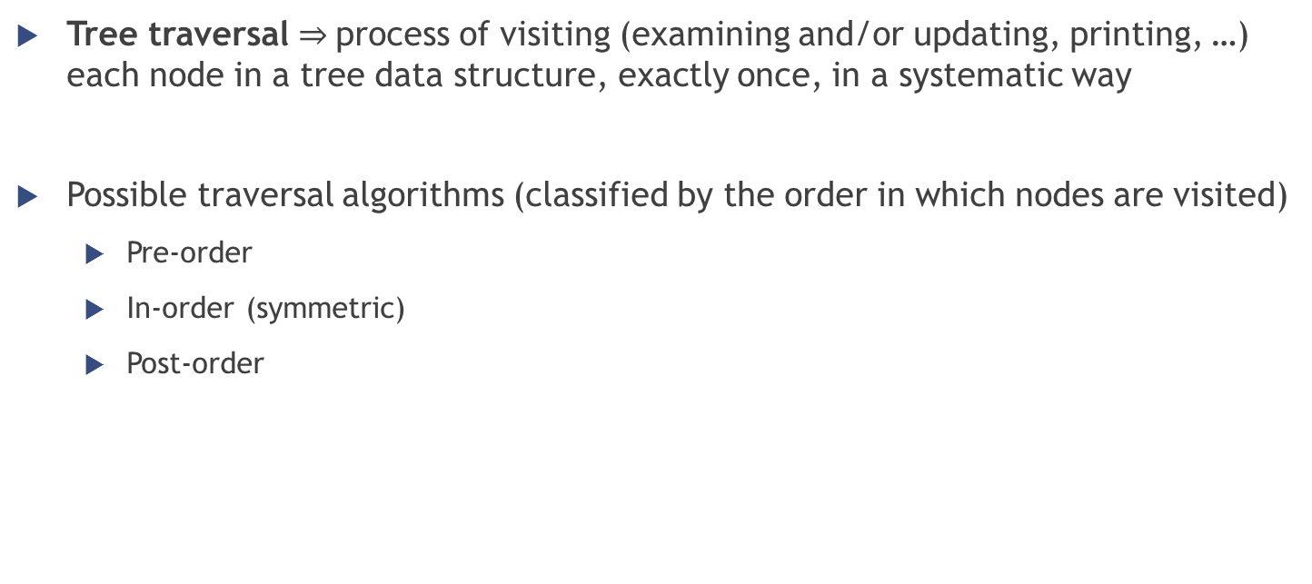
Traversing a binary tree
Tree traversal $⇒$process of visiting (examining and/or updating, printing, …) each node in a tree data structure, exactly once, in a systematic way
Possible traversal algorithms (classified by the order in which nodes are visited)
Pre-order
In-order (symmetric)
Post-order

Slide 16
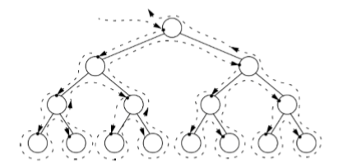
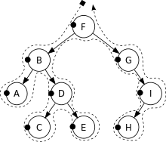
Traversing a binary tree
Pre-order
Visit the root
Traverse the left subtree
Traverse the right subtree
In-order
Traverse the left subtree
Visit the root
Traverse the right subtree
Post-order
Traverse the left subtree
Traverse the right subtree
Visit the root
Pre-order: F, B, A, D, C, E, G, I, H

Slide 17
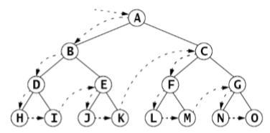
Traversing a binary tree
Pre-order
Visit the root
Traverse the left subtree
Traverse the right subtree
In-order
Traverse the left subtree
Visit the root
Traverse the right subtree
Post-order
Traverse the left subtree
Traverse the right subtree
Visit the root

Slide 18
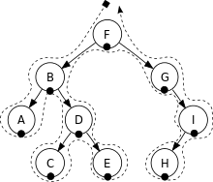
Traversing a binary tree
Pre-order
Visit the root
Traverse the left subtree
Traverse the right subtree
In-order
Traverse the left subtree
Visit the root
Traverse the right subtree
Post-order
Traverse the left subtree
Traverse the right subtree
Visit the root
In-order: A, B, C, D, E, F, G, H, I

Slide 19
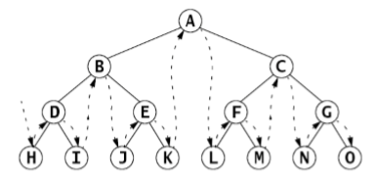
Traversing a binary tree
Pre-order
Visit the root
Traverse the left subtree
Traverse the right subtree
In-order
Traverse the left subtree
Visit the root
Traverse the right subtree
Post-order
Traverse the left subtree
Traverse the right subtree
Visit the root

Slide 20

Traversing a binary tree
Pre-order
Visit the root
Traverse the left subtree
Traverse the right subtree
In-order
Traverse the left subtree
Visit the root
Traverse the right subtree
Post-order
Traverse the left subtree
Traverse the right subtree
Visit the root
Post-order: A, C, E, D, B, H, I, G, F

Slide 21
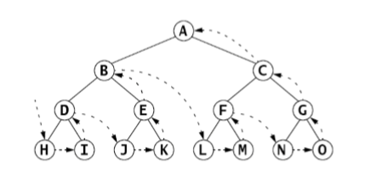
Traversing a binary tree
Pre-order
Visit the root
Traverse the left subtree
Traverse the right subtree
In-order
Traverse the left subtree
Visit the root
Traverse the right subtree
Post-order
Traverse the left subtree
Traverse the right subtree
Visit the root

Slide 22
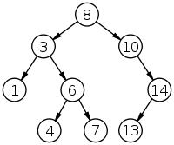
Traversing a binary tree
Exercise
Show the resulting sequence of numbers obtained by traversing the following binary tree using the following traversal algorithms
Preorder
Inorder
Postorder

Slide 23
Binary Search Trees

Slide 24
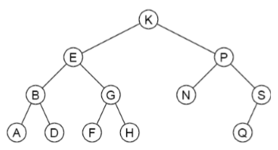

Binary search tree definition
A binary search tree is a binary tree whose elements include a key field of some ordinal type and which has this property:
If $k$ is the key value at any node, then $k≥ x$ for every key $x$ in the node’s left subtree and $k≤ y$ for every key $y$ in the node’s right subtree
Also called “BST property”

Slide 25
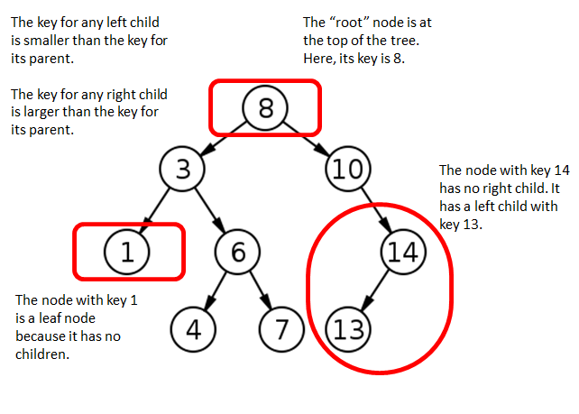
Binary search tree

Slide 26

Binary search tree property
Because of the BST property…
in-order traversal $⇒$ sorted sequence of elements in increasing order
$A, B, D,E, F, G, H, K, N, P, Q, S$ $1, 3, 4, 6, 7, 8, 10, 13, 14$

Slide 27
Binary search tree operations
What can we do with a binary search tree?
Search if it contains a specific element
Insert a new element
Delete a specific element

Slide 28
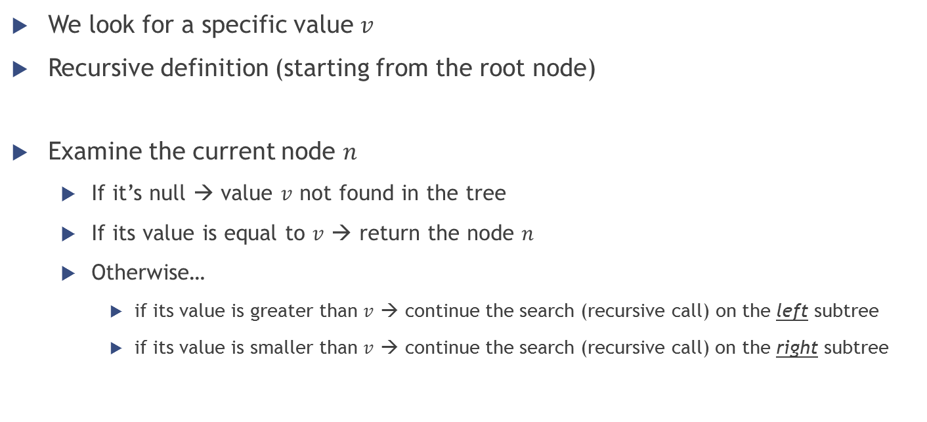
Binary search tree – Search
We look for a specific value $v$
Recursive definition (starting from the root node)
Examine the current node $n$
If it’s null → value $v$ not found in the tree
If its value is equal to $v$ → return the node $n$
Otherwise…
if its value is greater than $v$ → continue the search (recursive call) on the left subtree
if its value is smaller than $v$ → continue the search (recursive call) on the right subtree

Slide 29
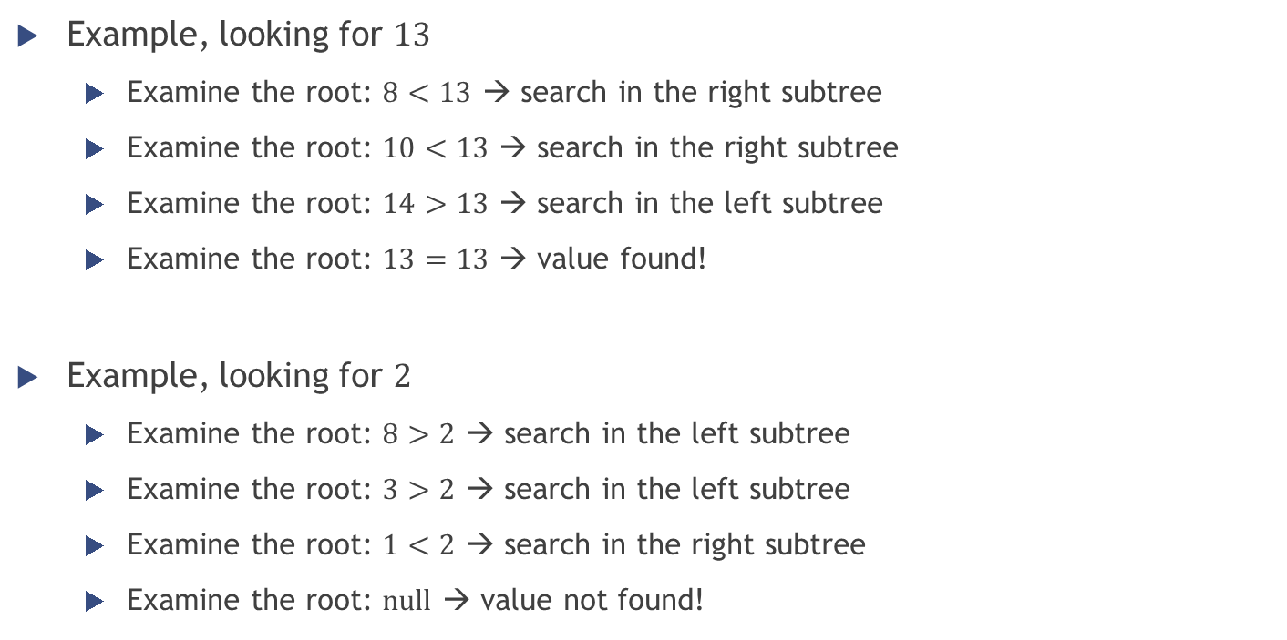
Binary search tree – Search
Example, looking for $13$
Examine the root: $8<13$ → search in the right subtree
Examine the root: $10<13$ → search in the right subtree
Examine the root: $14>13$ → search in the left subtree
Examine the root: $13=13$ → value found!
Example, looking for $2$
Examine the root: $8>2$ → search in the left subtree
Examine the root: $3>2$ → search in the left subtree
Examine the root: $1<2$ → search in the right subtree
Examine the root: $null$ → value not found!

Slide 30
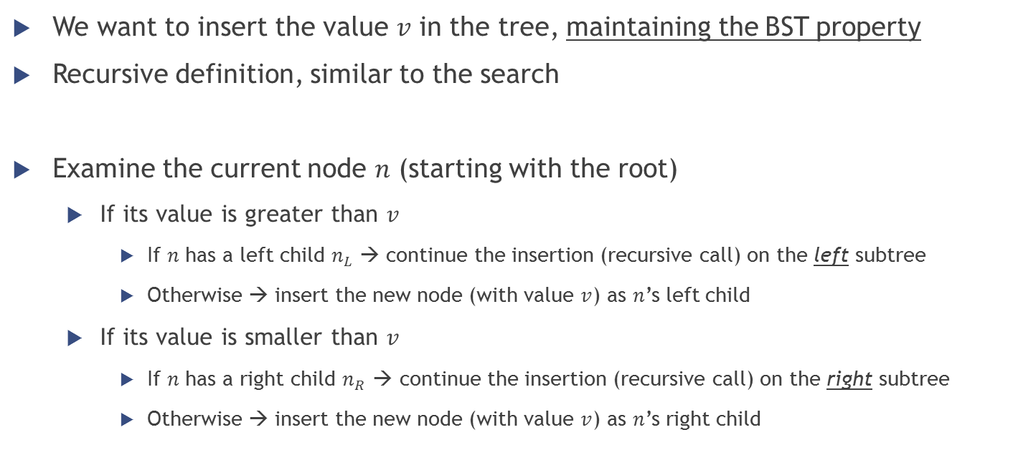
Binary search tree – Insertion
We want to insert the value $v$ in the tree, maintaining the BST property
Recursive definition, similar to the search
Examine the current node $n$ (starting with the root)
If its value is greater than $v$
If $n$ has a left child $n_{L}$ → continue the insertion (recursive call) on the left subtree
Otherwise → insert the new node (with value $v$) as $n$’s left child
If its value is smaller than $v$
If $n$ has a right child $n_{R}$ → continue the insertion (recursive call) on the right subtree
Otherwise → insert the new node (with value $v$) as $n$’s right child

Slide 31
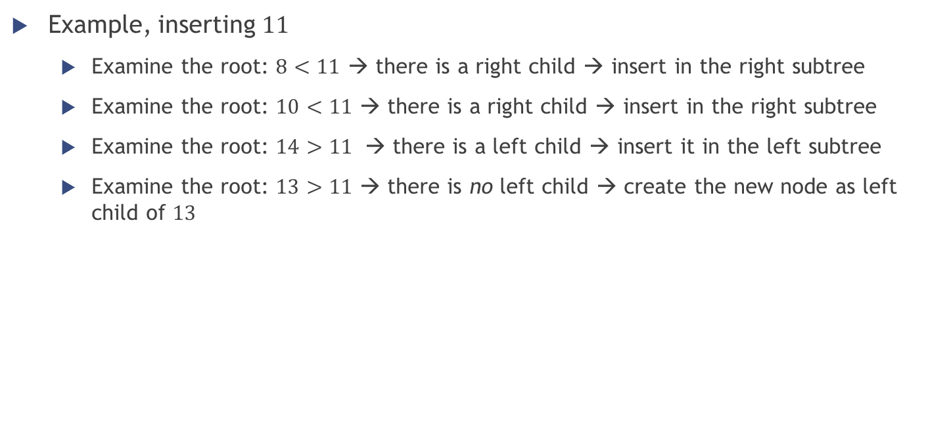
Binary search tree – Insertion
Example, inserting $11$
Examine the root: $8<11$ → there is a right child → insert in the right subtree
Examine the root: $10<11$ → there is a right child → insert in the right subtree
Examine the root: $14>11$ → there is a left child → insert it in the left subtree
Examine the root: $13>11$ → there is no left child → create the new node as left child of $13$
11

Slide 32

Binary search tree – Insertion
Example, inserting $2$
Examine the root: $8>2$ → there is a left child → insert in the left subtree
Examine the root: $3>2$ → there is a left child → insert in the left subtree
Examine the root: $1<2$ → there is no right child → create the new node as right child of $1$
2

Slide 33
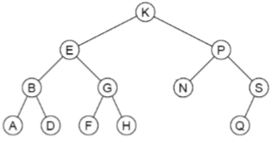
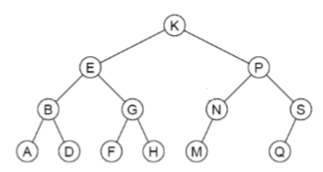

Binary search tree – Insertion
Example, inserting $M$
Examine the root: $K<M$ → there is a right child → insert in the right subtree
Examine the root: $P>M$ → there is a left child → insert in the left subtree
Examine the root: $N>M$ → there is no left child → create the new node as left child of $N$

Slide 34

Binary search tree – Insertion
Exercise
Given the following sequence of numbers, draw a binary search tree by inserting such numbers from left to right.
$$11, 6, 8, 19, 4, 10, 5, 17, 43, 49, 31$$

Slide 35
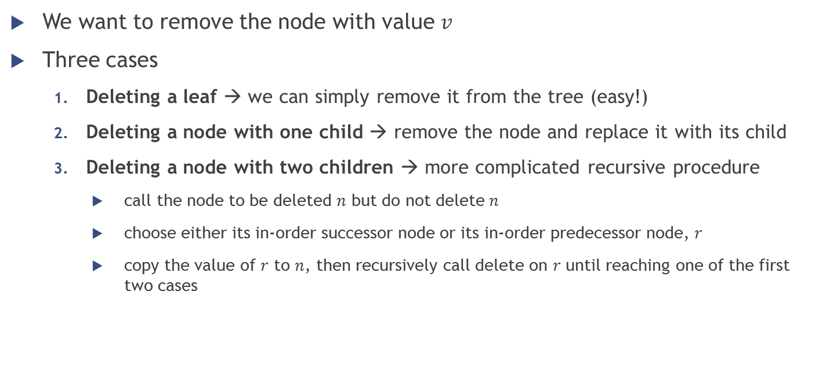
Binary search tree – Deletion
We want to remove the node with value $v$
Three cases
Deleting a leaf → we can simply remove it from the tree (easy!)
Deleting a node with one child → remove the node and replace it with its child
Deleting a node with two children → more complicated recursive procedure
call the node to be deleted $n$ but do not delete $n$
choose either its in-order successor node or its in-order predecessor node, $r$
copy the value of $r$ to $n$, then recursively call delete on $r$ until reaching one of the first two cases

Slide 36
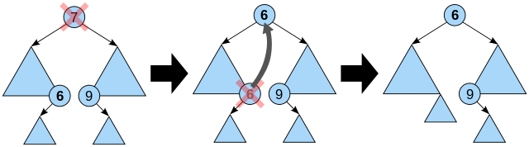
Binary search tree – Deletion
Smallest element of the right subtree
Case 3 (node with two children) is the most difficult
As with all binary trees…
a node's in-order successor is its right subtree's left-most child
a node's in-order predecessor is the left subtree's right-most child
Biggest element of the left subtree

Slide 37
Binary search tree – Deletion
Smallest element of the right subtree
Case 3 (node with two children) is the most difficult
As with all binary trees…
a node's in-order successor is its right subtree's left-most child
a node's in-order predecessor is the left subtree's right-most child
In either case, this node will have zero or one children. Delete it according to one of the two simpler cases.
Biggest element of the left subtree

Slide 38
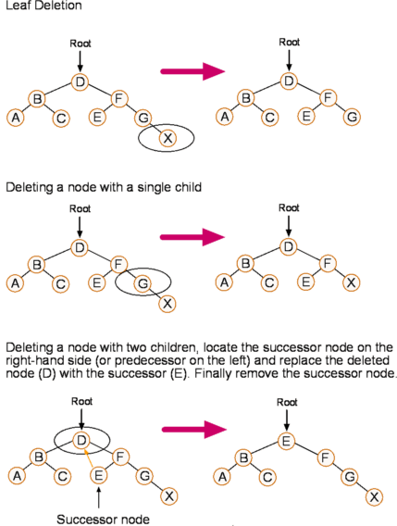
Binary search tree – Deletion
Examples

Slide 39
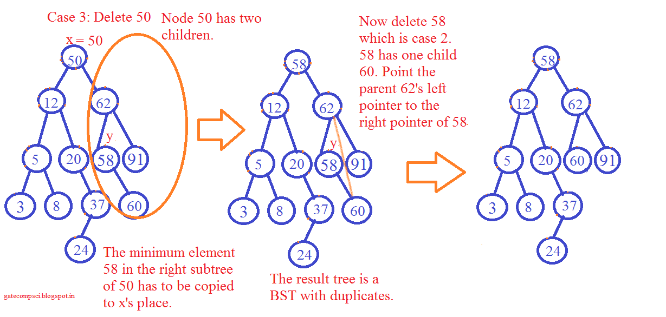

Binary search tree – Deletion
Example, deleting $50$

Slide 40
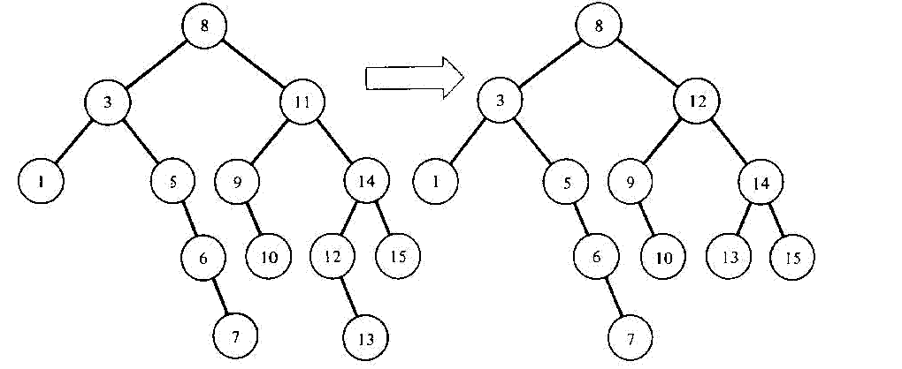
Binary search tree – Deletion
Example, deleting 11

Slide 41

Binary search tree – Deletion
Exercise
Given the following sequence of numbers, draw a binary search tree by inserting such numbers from left to right and then show the two trees that can be the result after the removal of 11.
$$11, 6, 8, 19, 4, 10, 5, 17, 43, 49, 31$$

Slide 42
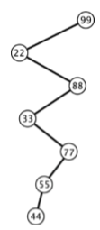
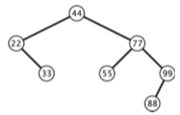
Binary search tree – Balanced vs unbalanced
Very efficient searching if a binary search tree is balanced
Without further restrictions, a binary search tree may grow to be very unbalanced
worst case when the elements are inserted in sorted order → the tree becomes almost linear
Inserting the input sequence
44, 22, 77, 55, 99, 88, 33
Inserting the input sequence
99, 22, 88, 33, 77, 55, 44

Slide 43
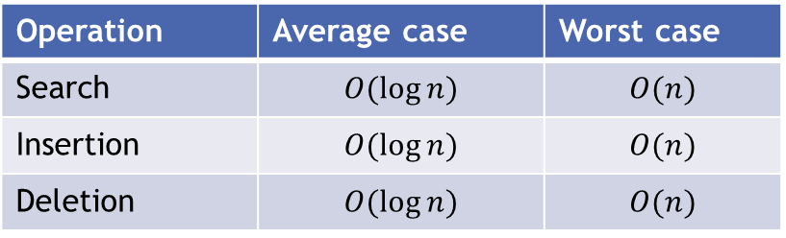
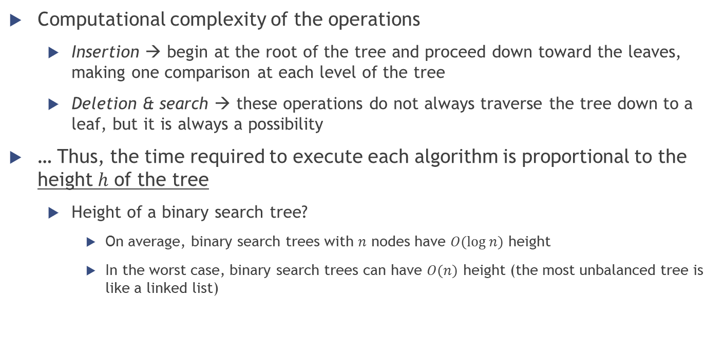
Binary search tree – Performance
Computational complexity of the operations
Insertion → begin at the root of the tree and proceed down toward the leaves, making one comparison at each level of the tree
Deletion & search → these operations do not always traverse the tree down to a leaf, but it is always a possibility
… Thus, the time required to execute each algorithm is proportional to the height $h$ of the tree
Height of a binary search tree?
On average, binary search trees with $n$ nodes have $O(\log{n})$ height
In the worst case, binary search trees can have $O(n)$ height (the most unbalanced tree is like a linked list)
Operation | Average case | Worst case
Search | $$O(\log{n})$$ | $$O(n)$$
Insertion | $$O(\log{n})$$ | $$O(n)$$
Deletion | $$O(\log{n})$$ | $$O(n)$$

Slide 44

BST in .NET
http://msdn.microsoft.com/en-us/library/ms379572(v=vs.80).aspx
C#: SortedSet
http://msdn.microsoft.com/en-us/library/dd412070.aspx
It is implemented using a self-balancing red-black tree that gives a performance complexity of $O(log⁡n)$ for insert, delete, and lookup. It is used to keep the elements in sorted order, to get the subset of elements in a particular range, or to get the Min or Max element of the set.

Slide 45
2-3 trees

Slide 46

2-3 trees
As we saw before, BST could be very unbalanced $⇒$ bad for performance!
2-3 trees
a type of binary search tree where costs are guaranteed to be logarithmic
near-perfect balance achieved through allowing nodes to hold more than one key

Slide 47

2-3 trees
Definition: a 2-3 search tree is a tree that either is empty or…
A 2-node, with one key (and associated value) and two links, a left link to a 2-3 search tree with smaller keys, and a right link to a 2-3 search tree with larger keys
A 3-node, with two keys (and associated values) and three links, a left link to a 2-3 search tree with smaller keys, a middle link to a 2-3 search tree with keys between the node's keys and a right link to a 2-3 search tree with larger keys.
A perfectly balanced 2-3 search tree (or 2-3 tree for short) is one whose null links are all the same distance from the root.

Slide 48

2-3 trees search

Slide 49


2-3 trees insertion
A bit more complicated (more cases to consider)
The simplest two cases …
Insert into a 2-node
Insert into a tree consisting of a single 3-node

Slide 50


k-d trees
K-dimensional trees

Slide 51
k-d trees
What is a k-d tree?
special case of binary space partitioning trees
space-partitioning data structure for organizing points in a k-dimensional space
useful data structure for several applications, such as searches involving a multidimensional search key (e.g. range searches and nearest neighbor searches)

Slide 52
k-d trees informal description
Binary tree in which every node is a k-dimensional point
Every non-leaf node can be thought of as implicitly generating a splitting hyperplane that divides the space into two parts, known as half-spaces
Points to the left of this hyperplane are represented by the left subtree of that node
Points right of the hyperplane are represented by the right subtree
Every node in the tree is associated with one of the k-dimensions, with the hyperplane perpendicular to that dimension's axis
for example, if for a particular split the "x" axis is chosen, all points in the subtree with a smaller "x" value than the node will appear in the left subtree and all points with larger "x" value will be in the right subtree

Slide 53
k-d trees construction
The canonical method of k-d tree construction has the following constraints:
As one moves down the tree, one cycles through the axes used to select the splitting planes
Example: in a 2-d tree, the root has an x-aligned plane, the root’s children would both have a y-aligned plane, the root’s grandchildren would have all x-aligned planes, etc…
Points are inserted by selecting the median of the points being put into the subtree, with respect to their coordinates in the axis being used to create the splitting plane
This method leads to a balanced k-d tree (i.e., each leaf node is approximately at the same distance from the root)
Note: if you do not choose the median, there is no guarantee that the tree will be balanced.

Slide 54
2-d trees example

Slide 55


2-d trees example
A
E
C
B
C
B
D
E
F
D
A
F

Slide 56


k-d trees and range searches
d
A range search searches for ranges of parameters
Example: if a tree is storing values corresponding to income and age, then a range search might be something like looking for all members of the tree which have an age between 20 and 50 years and an income between 50,000 and 80,000
Since k-d trees divide the range of a domain in half at each level of the tree, they are useful for performing range searches
Other example: suppose you store various types of buildings in a k-d tree. You are looking for special buildings within a certain distance $d$ from a house… this is exactly a range search, where the $x$ coordinate of the building should be between $[x_{h}−d,x_{h}+d]$ and the $y$ coordinate between $[y_{h}−d, y_{h}+d]$ (supposing that $x_{h}$ and $y_{h}$ are the coordinates of the house). After this you can check if the buildings found are really within radius $d$ from the house (using the Euclidean distance).
The tree can be created only once and then used for all the needed searches.

Slide 57

Homework
Study the slides
Answer the MC questions on GrandeOmega
Implement $BinarySearchTree<T>$
with traversals (all 3), insert, search and delete operations
See you next week ☺

